Slide 1
Welcome Back to SIS!
2014-2015 School Year

Slide 2
Introductions
Please introduce yourself by answering these questions:
1) What’s your name?
2) Where are you from?
3) What did you do over the summer?
4) Tell me one random fact about you!
5) If you had one superpower, what would you have and why.

Slide 3
Outline for the Year- SOSE
This year we will study four topics in SOSE to help you prepare for the IGCSE and GAC level exams.
The topics will be:
Semester 1
Term 1: Tradition, Culture and Identity
Term 2: Belief Systems
Semester 2
Term 3: Law and Criminality
Term 4: Peace and Conflict

Slide 4
Identity: What is it?
Mr. Daan will break you up into groups of 3 or 2 and you will have 5 minutes as a group to come up with a definition that you will have to present to the class. Be sure that all of your group members know what the definition is because Mr. Daan will randomly choose a group member to read your definition out to the class…

Slide 5
Identity is (class brainstorm):

Slide 6
Identity is:
The qualities, beliefs, etc., that make a particular person or group different from others.

Slide 7
What is your Identity?
A person’s identity is made of up of many different things. Can you give me some examples of what makes up someone’s identity?

Slide 8
Mr. Daan’s Identity
O.K. now that you are grasping the concept of Identity can you list some of the factors that make up Ms. Laurel’s Identity?

Slide 9
Other parts of identity
You know Mr. Daan’s identity as a teacher but his whole identity is much more then that.
Do you know anything about his family?
Where He traveled?
What/who have influenced him in his life?
What his favorite things to do in his spare time are?
What he values most in his life?
Who is the most important to him?
What goals, aspirations and dreams does He have?
How does he learn best?
Does he practice a religion?

Slide 10
Other parts of identity cntd.
Even all of these questions don’t fully encompass one persons full identity, you would have to know about their experiences throughout their life, how they react in different situations, what they value and where they come as well as their family’s background and personalities among many other things.

Slide 11
Assignment:
To prove your understanding of the concept of identity I would like for you to make a visual representation of yourself. You can use words done in an artistic way to represent the different things that are a part of your identity. You can use pictures or a combination of the two. You need to have at least 10 different aspects of yourself represented visually.

Slide 12
You will be graded on the following:
10 marks for 10 different visuals representing a different aspect of yourself. The visuals need to be listed on the back of your visual representation.
5 marks for visual appeal, neatness and effort
2 marks for your name in an artistic way

Slide 13
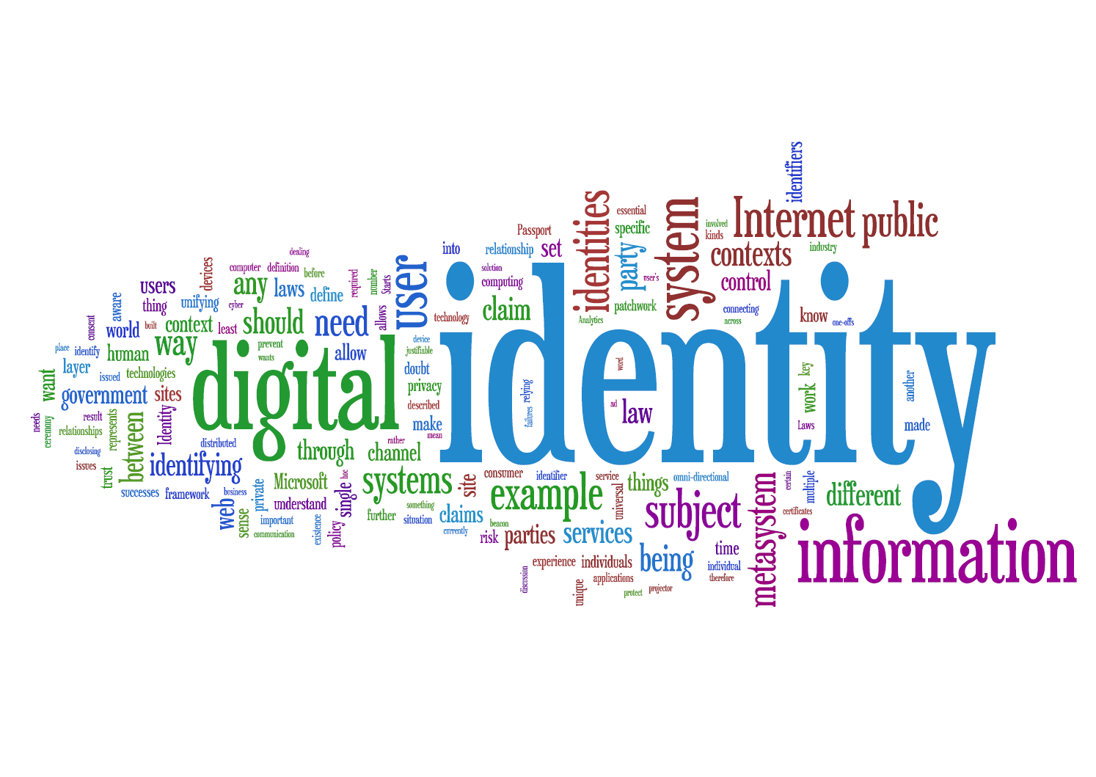
Examples:

Slide 14
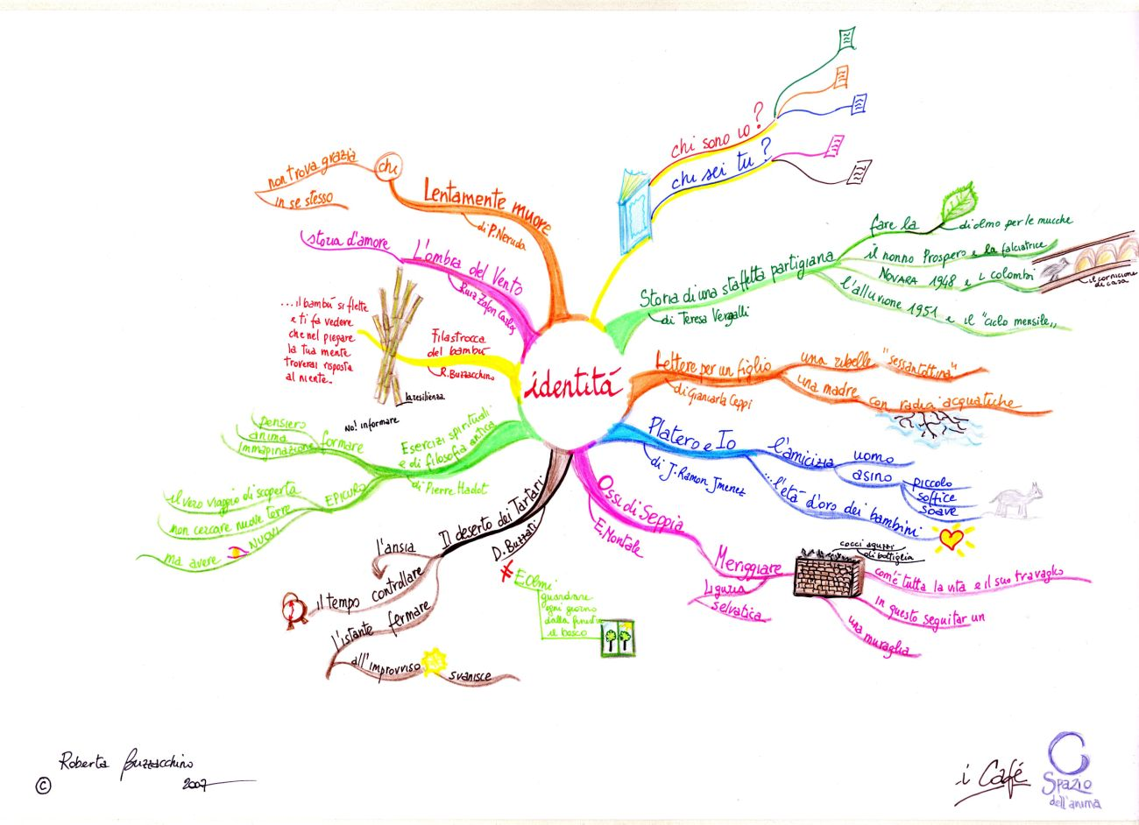
Examples:

Slide 15
Examples:

