Slide 1
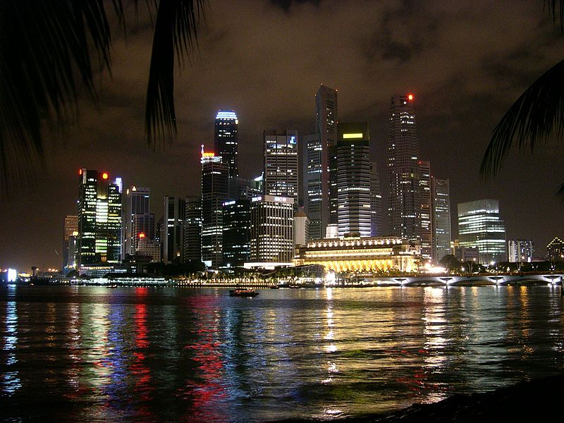
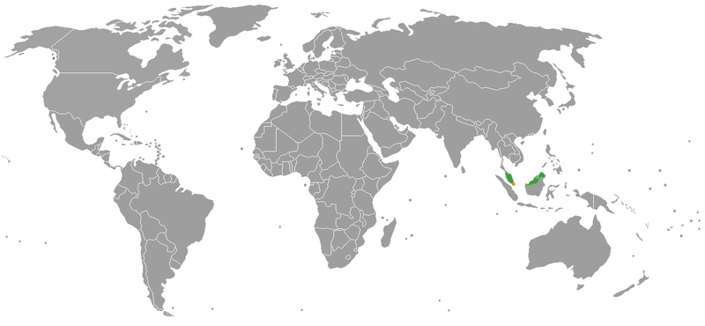
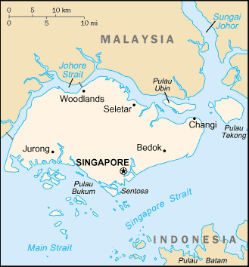

Singapore
Geo_Y06_U1_SS_Singapore

Slide 2
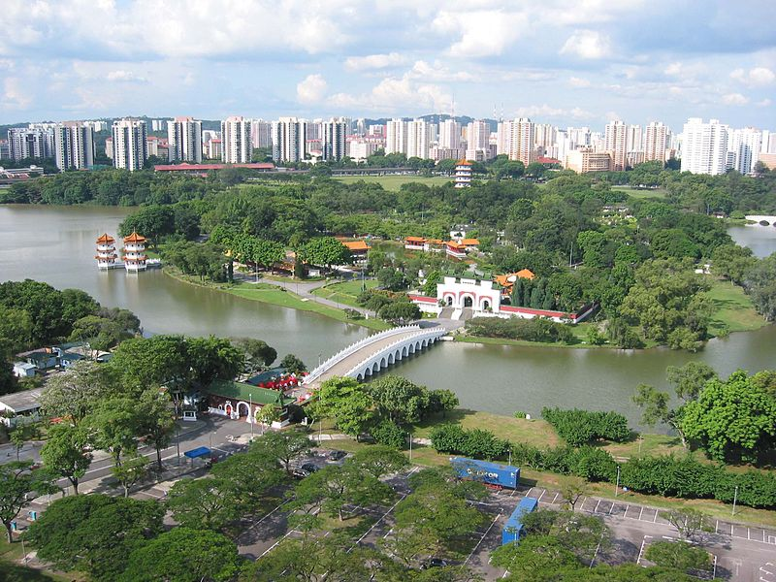
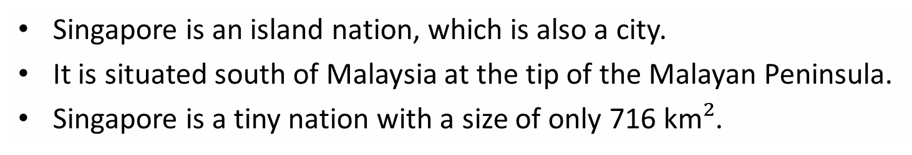
About Singapore
Singapore is an island nation, which is also a city.
It is situated south of Malaysia at the tip of the Malayan Peninsula.
Singapore is a tiny nation with a size of only 716 km$²$.
Geo_Y06_U1_SS_Singapore
Notes:
Singapore is an island nation, which is also a city. It is situated south of Malaysia and is a tiny nation with a size of only 716 km².

Slide 3
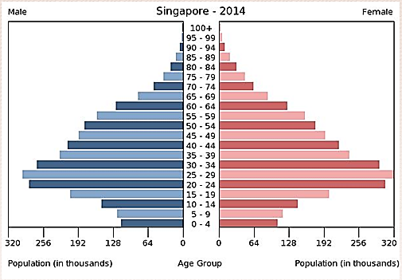
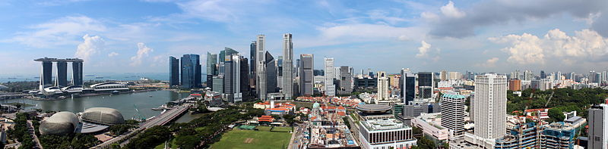
About Singapore’s population
Singapore is the 116th most populous nation in the world (5.56 million people as of June 2014), with the average age being 33.
It is the 3rd highest country per capita for population density.
Singapore has been considered 100% urbanised since 2011
Data sourced from: World factbook (CIA) https://www.cia.gov/library/publications/the-world-factbook/geos/sn.html
Notes:
Singapore is the 116th most populous nation in the world (5.56 million people as of June 2014). The average age is 33.
Singapore is the 3rd highest country per capita for population density. It has been considered 100% urbanised since 2011.

Slide 4
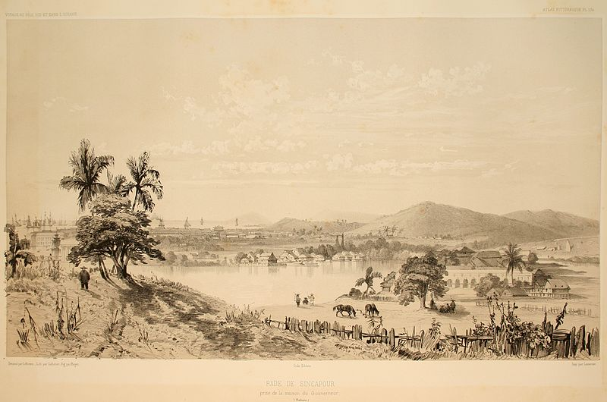
History
Founded as a British colony in 1819.
For centuries Singapore was part of British Malaya.
During British rule the port of Singapore attracted many migrants.
Singapore joined the Malaysian Federation in 1963 but separated two years later and became independent.
Notes:
Singapore was founded as a British trading colony in 1819. During British rule, the port of Singapore thrived and attracted many migrants from China, the Indian sub-continent, Indonesia, the Malay Peninsula and the Middle East. Singapore joined the Malaysian Federation in 1963 but separated two years later and became independent. Today Singapore is one of the world's most prosperous countries with strong international trading links (its port is one of the world's busiest).

Slide 5
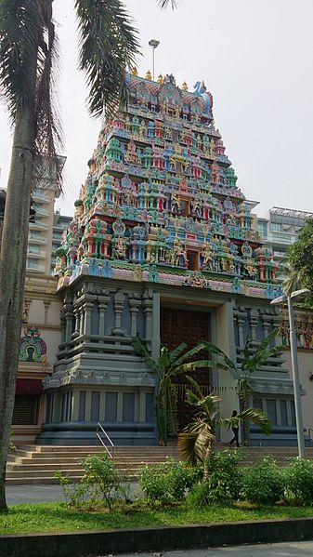
Ethnic composition of Singapore, 2012.
Singapore has a diverse population of nearly 5 million people made up of Chinese, Malays, Indians, Caucasians and Eurasians, and Asians of different origins.
Data sourced from: Population trends 2012, Department of Statistics, Singapore.
Notes:
It has a diverse population of nearly 5 million people made up of Chinese, Malays, Indians, Caucasians and Eurasians and Asians of different origins. 42% of Singapore's population are foreigners.

Slide 6
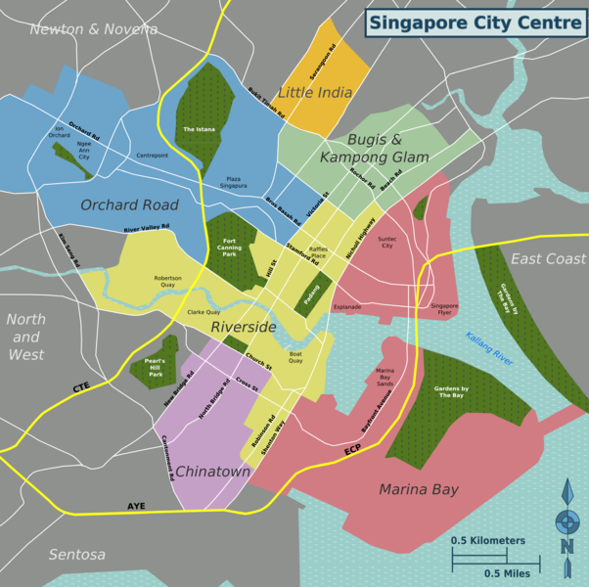
Little India
Kampong Glam
The city of Singapore has areas that reflect its diverse ethnic composition.
Chinatown
Notes:
Singapore has several distinct ethnic neighbourhoods including (click) Little India, (click) Chinatown and (click) Kampong Glam formed in the early 19th century to separate the new immigrants into specific areas. Prior to colonisation by the British in 1819, Kampong Glam was home to the Malay aristocracy of Singapore. There were also areas set aside for Europeans.

Slide 7
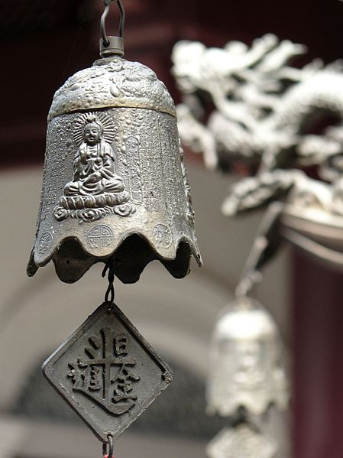
How people communicate in Singapore (languages)
The diversity of the culture in Singapore is reflected in the many languages spoken there. The four main languages are Mandarin, English, Malay and Tamil.
Data sourced from: World factbook (CIA) https://www.cia.gov/library/publications/the-world-factbook/geos/sn.html
Notes:
The diversity of the culture in Singapore is also reflected in the many languages spoken there. The four main languages are Mandarin, English, Malay and Tamil.

Slide 8
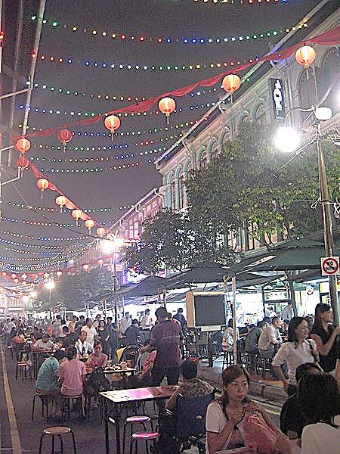
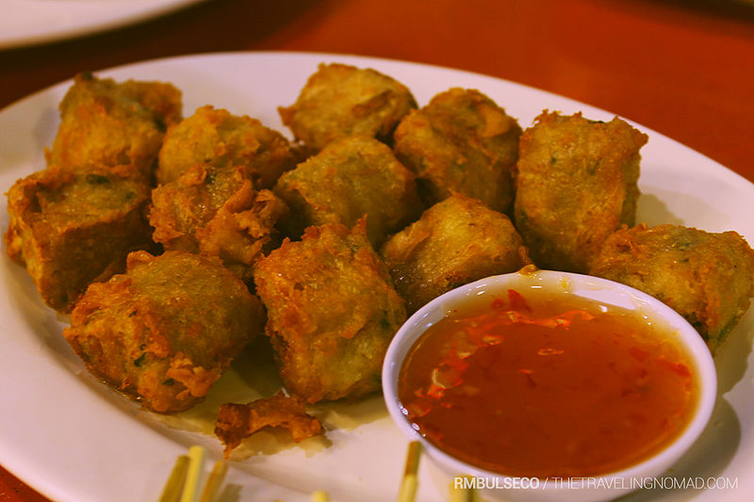
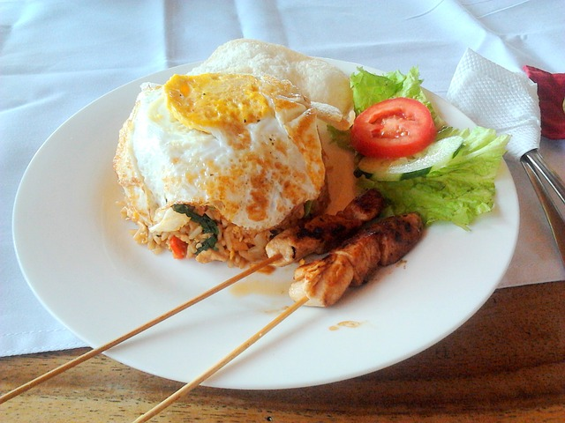
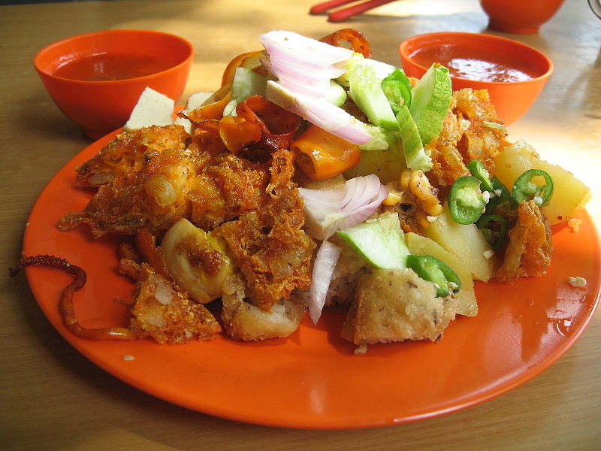
How people shelter, clothe and nourish
themselves in Singapore (food, clothes and homes).
Indian influence:
Dishes from both the North Indian region and the South Indian region can be found in Singapore.
Indonesian and Malay influence:
Many dishes influenced by the food of neighbouring regions such as Malaysia, Sumatra and Java have been adapted to suit local tastes.
Chinese influence:
Many dishes were brought to Singapore by early Southern Chinese immigrants and adapted to suit local circumstances such as available ingredients.
Notes:
Singapore cuisine is another example of diversity and the mixing of cultures. The food in Singapore is influenced by a number of cultures including the local Malay culture, Chinese, Indonesian, Indian and Western cultures. Influences from other areas such as Sri Lanka, Thailand, Philippines, and the Middle East exist in the local food culture as well.
For example chefs of Chinese background have been influenced by (click) Indian culture and experimented with condiments and ingredients such as tamarind, turmeric, and ghee while an Indian chef might serve a fried noodle dish.
(click) Malay ingredients and cooking techniques have been incorporated into Chinese dishes. (click) This continues to make the foods of Singapore significantly rich and a real cultural attraction.

Slide 9
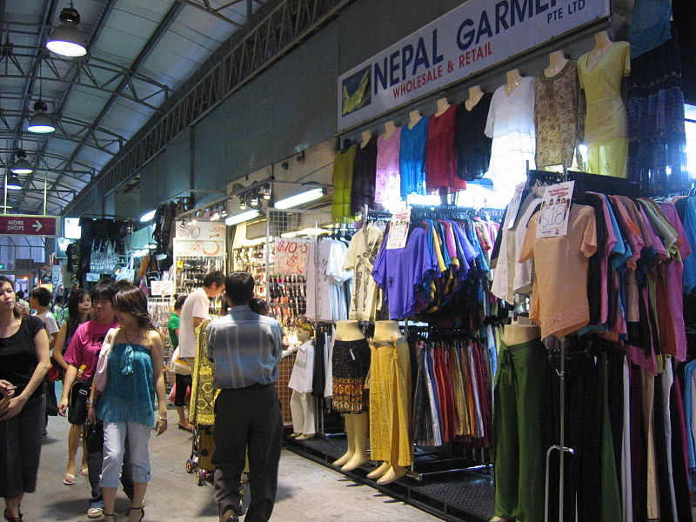
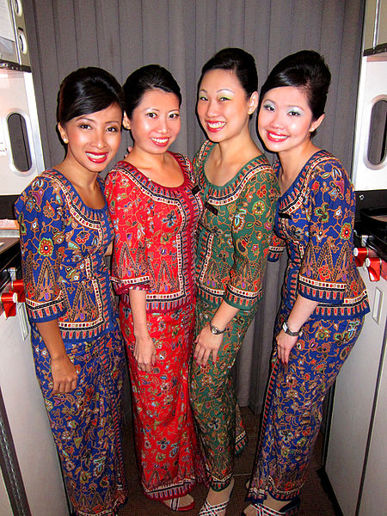
How people shelter, clothe and nourish themselves in Singapore (food, clothes and homes).
Notes:
Due to different ethnic groups in Singapore and the modern character of Singaporeans, there are many different types of clothing worn in Singapore. Dress is normally very casual. Western clothing is most common. A sarong kebaya in batik material is the signature uniform of Singapore Airlines and reflects the airline’s Asian heritage and is a dress most commonly associated with Singaporean culture.

Slide 10
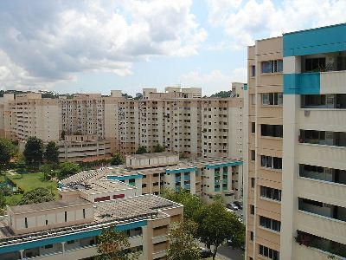
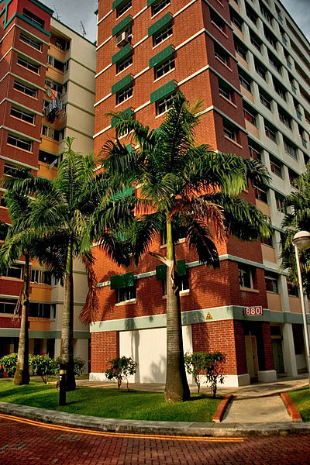
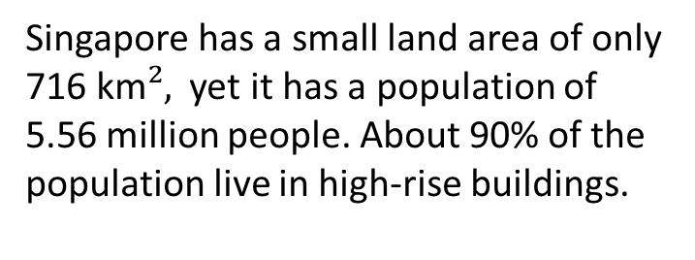
How people shelter, clothe and nourish
themselves in Singapore (food, clothes and homes).
Singapore has a small land area of only 716 km$²,$ yet it has a population of 5.56 million people. About 90% of the population live in high-rise buildings.
Notes:
Singapore has a small land area of only 716 km$², yet it has a polaution of$ 5.56 million people. About 90% of the population lives in high-rise buildings.

Slide 11
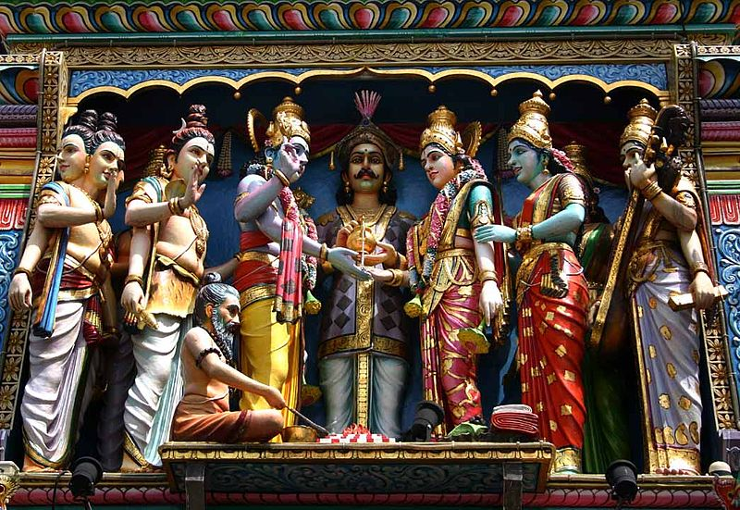
How people make spiritual connections in Singapore (religion and beliefs)
Data sourced from: World factbook (CIA) https://www.cia.gov/library/publications/the-world-factbook/geos/sn.html
Notes:
There are six major religions practised in Singapore. The variety of religions is a direct reflection of the diversity of ethnic groups living there. From the foundation of the city, authorities have avoided interfering with the religious affairs of the many ethnic groups who arrived in the country over time, fostering an atmosphere of religious tolerance.

Slide 12
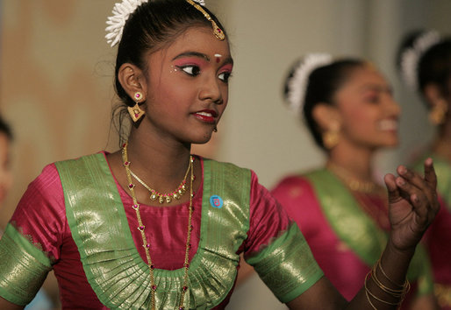
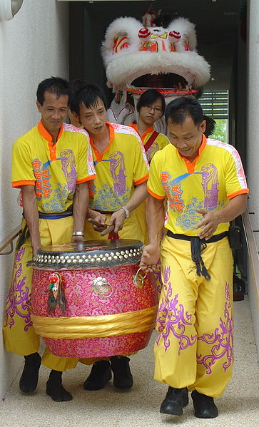
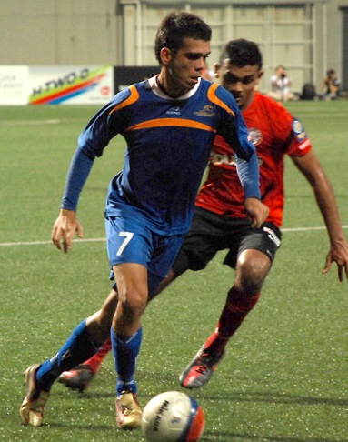
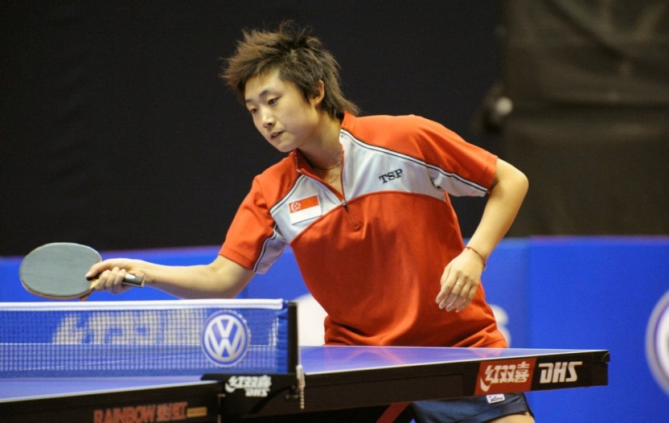
How people entertain and are entertained in Singapore (music, dance, art, sport)
Notes:
Sport is also diverse in Singapore. Singaporeans participate in a wide variety of sports for recreation as well as for competition. Popular sports include football (soccer), cricket, rugby union, swimming, badminton, basketball, cycling and table tennis. Living on an island surrounded by the ocean, the people also enjoy many water activities including sailing, kayaking and water-skiing.

Slide 13
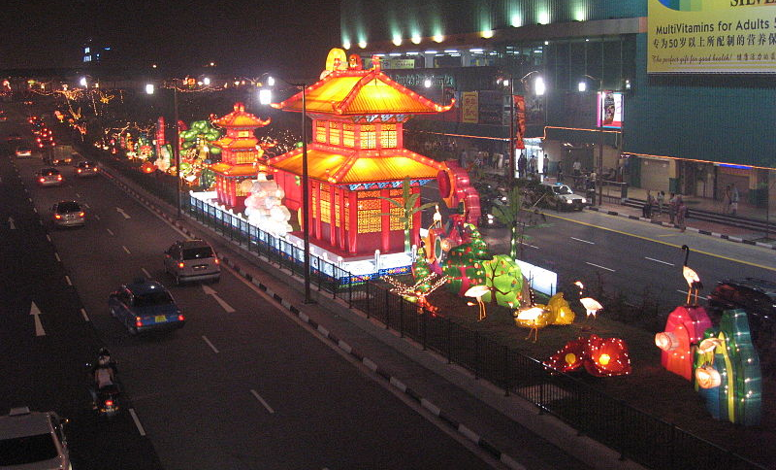
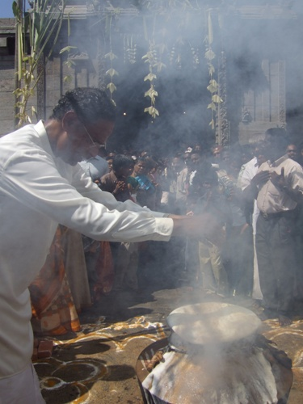
How people celebrate in Singapore
(gatherings and festivals)
A traditional Chinese harvest festival, the Mid-Autumn Festival is also known as the Lantern or Mooncake Festival. A Mid-Autumn festival is held in Singapore each year.
Pongal is a four day celebration of a good harvest celebrated by the local Tamil community.
Notes:
Festivals and cultural celebrations are also diverse and reflect the diversity of ethnic groups living in Singapore. Many Singaporeans and visitors to Singapore participate in festivals and celebrations outside of their own traditional cultures. In this way, groups are able to share elements of their culture with others.

Slide 14
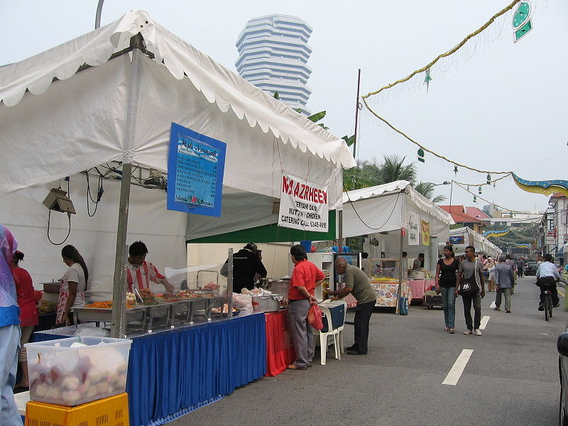
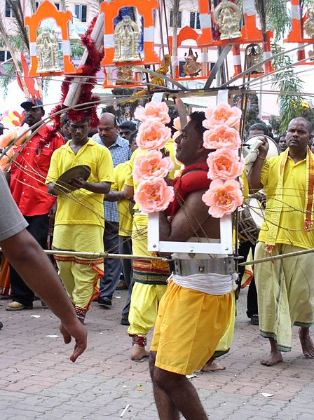
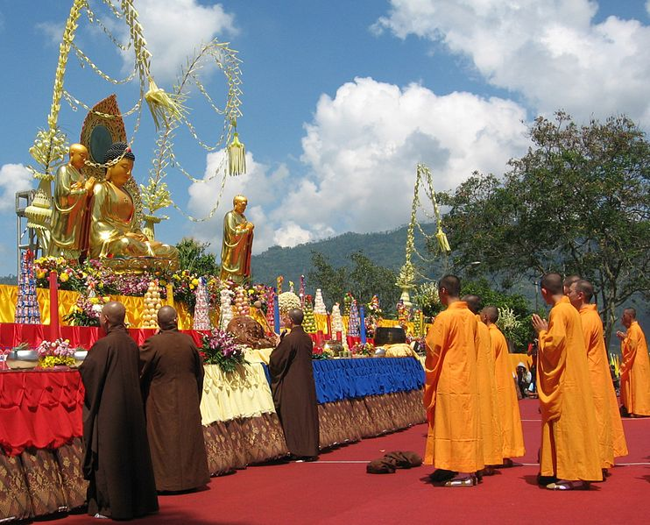
How people celebrate in Singapore (gatherings and festivals)
Hari Raya Haji, or Eid ul-Fitr (‘Festival of sacrifice’) is celebrated over four days by Muslims to mark the end of Ramadan.
Vesak Day is the most significant day of the year in the Buddhist calendar. The day celebrates the birth and death of the Buddha.
Thapusam
A Hindu festival celebrated by Singapore’s Tamil community.

Slide 15
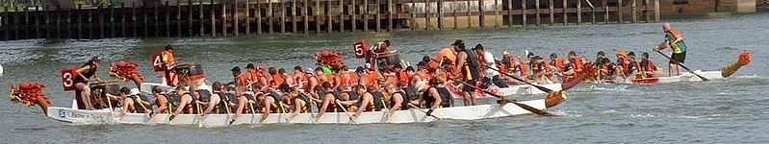
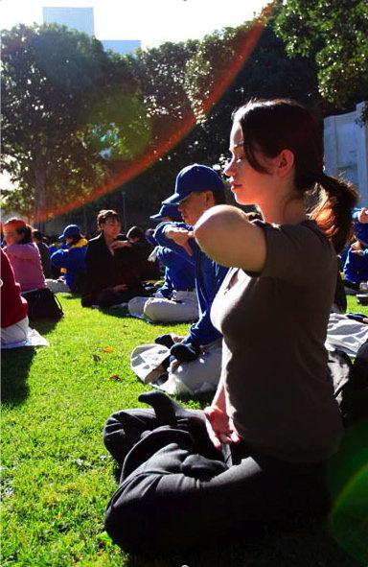
How people connect past and present in Singapore (customs and traditions)
Dragon Boat racing events are a Chinese custom that dates back to ancient times. Dragon boat races are held every year in Singapore.
Buddhism is one of the religions practised in Singapore.
Meditation is a custom in Buddhism that has been practised since early times and continues to be practised today.
Notes:
Many customs and traditions are maintained in contemporary Singapore. Continuing practices of the past is one way that people make connections between the past and present, and keep their culture alive and thriving.

Slide 16
Attributions
Slide 1:
http://commons.wikimedia.org/wiki/File:Singapore_at_night.jpg
World factbook (CIA) https://www.cia.gov/library/publications/the-world-factbook/geos/sn.html
http://commons.wikimedia.org/wiki/File:Malaysia_and_Singapore_locator_map.png
Slide 2:
Modified from: Groyn88 2005, Southern to middle part of Jurong Lake, Singapore http://commons.wikimedia.org/wiki/File:Southern_to_middle_part_of_Jurong_Lake,_Singapore.jpg CC BY-SA 3.0 creativecommons.org/licenses/by-sa/3.0/deed.en
Slide 3:
World factbook (CIA) https://www.cia.gov/library/publications/the-world-factbook/geos/sn.html
Modified from: Joan Campderrós-i-Canas from Rubí, Catalunya, Singapore's skyline http://commons.wikimedia.org/wiki/File:Singapore%27s_skyline.jpg CC BY 2.0 http://creativecommons.org/licenses/by/2.0/deed.en
Slide 4:
http://commons.wikimedia.org/wiki/File:Atlas_pittoresque_pl_134.jpg
Slide 5:
http://commons.wikimedia.org/wiki/File:Hindu_Temple_Singapore.jpg
Slide 6:
Modified from: Torty3, Central Singapore Districts http://commons.wikimedia.org/wiki/File:Central_Singapore_Districts.png CC BY-SA 3.0 creativecommons.org/licenses/by-sa/3.0/deed.en
Slide 7:
Yeowatzup, Thiam Hock Keng Temple, Singapore http://commons.wikimedia.org/wiki/File:Thiam_Hock_Keng_Temple,_Singapore_(2318435536).jpg CC BY 2.0 creativecommons.org/licenses/by/2.0/deed.en

Slide 17
Slide 8:
Modified from: Ong, T., Smith Street http://commons.wikimedia.org/wiki/File:Smith_Street_4.JPG CC BY-SA 3.0 creativecommons.org/licenses/by-sa/3.0/deed.en
http://pixabay.com/en/nasi-bali-sate-241166/
Modified from: Ong, T., Indian rojak http://commons.wikimedia.org/wiki/File:Indian_rojak.JPG CC BY-SA 3.0 creativecommons.org/licenses/by-sa/3.0/deed.en
Modified from: Bulseco, RM, Hay cho in Singapore http://commons.wikimedia.org/wiki/File:Hay_cho_in_Singapore_-_20140214.jpg CC BY 2.0 creativecommons.org/licenses/by/2.0/deed.en
Slide 9:
Franz, R., Singapore Airlines Hostesses http://commons.wikimedia.org/wiki/File:Singapore_Airlines_Hostesses.JPG CC BY creativecommons.org/licenses/by/2.0/deed.en
Ong, T., Bugis village 15 http://commons.wikimedia.org/wiki/File:Bugis_Village_15.JPG CC BY-SA 3.0 creativecommons.org/licenses/by-sa/3.0/deed.en
Slide 10:
Nuenenorl, S., Block 880, Woodlands Street 82, Singapore http://commons.wikimedia.org/wiki/File:Block_880,_Woodlands_Street_82,_Singapore.jpg CC BY-SA 3.0 creativecommons.org/licenses/by-sa/3.0/deed.en
mailer_diablo, Housing estate at Bukit Batok East, Bukit Batok, Singapore http://commons.wikimedia.org/wiki/File:BukitBatokEast-SG.JPG CC BY-SA 3.0 creativecommons.org/licenses/by-sa/3.0/deed.en
Slide 11:
Evans, S., Sri Krishnan Temple, Singapore http://commons.wikimedia.org/wiki/File:Sculptures_in_Sri_Krishnan_Temple,_Singapore_-_20040403.jpg CC BY 2.0 creativecommons.org/licenses/by/2.0/deed.en

Slide 18
Slide 12:
Yong Chee Meng, Feng Tianwei - Womens World Cup – Kuala Lumpur http://commons.wikimedia.org/wiki/File:FengTianwei-WomensWorldCup-KualaLumpur-20080907.jpg CC BY 2.0 creativecommons.org/licenses/by/2.0/deed.en
Six.stomachs, Guntur Djafril http://commons.wikimedia.org/wiki/File:Guntur_Djafril.JPG CC BY-SA 3.0 creativecommons.org/licenses/by-sa/3.0/deed.en
http://commons.wikimedia.org/wiki/File:Traditional_Singapore_dance.jpg
Modified from: Santimano, E., A lion dance troupe carrying a drum during Chinese New Year in Singapore http://commons.wikimedia.org/wiki/File:LionDanceTroupe-Drum-ChineseNewYear-Singapore-20090126.jpg CC BY 2.0 creativecommons.org/licenses/by/2.0/deed.en
Slide 13:
Ong, T., Mid-Autumn Festival, Chinatown http://commons.wikimedia.org/wiki/File:Mid-Autumn_Festival,_Chinatown_27,_102006.JPG CC BY-SA 3.0 creativecommons.org/licenses/by-sa/3.0/deed.en
http://commons.wikimedia.org/wiki/File:Thai_Pongal_at_Sivan_8.jpg
Slide 14:
Tajai / June, Thaipusam7 http://commons.wikimedia.org/wiki/File:Thaipusam7.jpg CC BY 2.0 creativecommons.org/licenses/by/2.0/deed.en
Modified from: Sengkang, http://commons.wikimedia.org/wiki/File:Hari_Raya,_Kampong_Glam,_Oct_06.JPG
Pwbaker, Vesak day http://commons.wikimedia.org/wiki/File:Vesak_Day_2555.jpg CC BY 2.0 creativecommons.org/licenses/by/2.0/deed.en
Slide 15:
http://commons.wikimedia.org/wiki/File:Dragonboat_singapore.jpg
longtrekhome, Sitting Meditation with Plasma phenomenon http://commons.wikimedia.org/wiki/File:SittingMeditationWithPlasmaPhenomenon.jpg CC BY 2.0 creativecommons.org/licenses/by/2.0/deed.en

