Slide 1
Types of Communication

Slide 2
Introduction
Most animals communicate with each other in some way. Dogs bark at those they perceive as a threat in order to communicate their hostility and in some cases the threat that they will attack if provoked; bees have a pouch in which they carry the scent of their hive so as to identify themselves as members of the community.

Slide 3
4 Types of Communication
Verbal Communication
Non Verbal Communication
Formal Communication
Informal Communication

Slide 4
Four Purposes of Communication
There are 4 purposes of communication
What do you think they are?

Slide 5
Purpose One
1. communication can be used to convey information

Slide 6
Purpose 2
2. communication can be used to ask for help.
verbal requests also mean that a request can be stated clearly and any miscommunication can be immediately rectified.

Slide 7
Purpose 3
The third purpose of communication is to influence a listener or audience.
This is the type of communication used by politicians
This is the most important component of influencing an audience

Slide 8
Purpose 4
The fourth and final form is entertainment.
most of the top comedians in the country make their living in live shows where they can readily interact with an audience rather than in text-based communication like books or websites

Slide 9
Forms of Communication
Now lets look at the 4 forms of communication. What do you think they are?

Slide 10
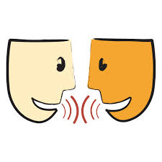
Verbal Communication
communication using words
verbal communication continues to be the most important aspect of our interaction with other people.

Slide 11
Advantages of Verbal Communication
we can slow down and present points one-by-one and make sure that each point is clearly communicated and understood before moving on to the next point.
Verbal communication is also the most effective way of explaining intangible concepts

Slide 12
Disadvantages of Verbal Communication
can also be quickly forgotten, especially if there are multiple points to consider
there is always the possibility of miscommunications leading to angry responses or quick escalation of a situation that could be less intense in written form

Slide 13
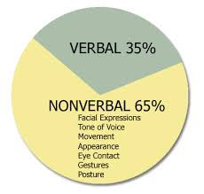
Form 2: Non Verbal Communication
Nonverbal communication is any kind of communication not involving words.
facial expressions and gestures.
vocal sounds that are not words such as grunts, sighs, and whimpers

Slide 14
Non Verbal Communication
Nonverbal communication can be incorporated in a person’s dress.
In our society, a person wearing a police uniform is already communicating an important message before they say a word.

Slide 15
Cultural Non Verbal Cues
Many cues are based on learned cultural standards.
What are a few cultural non verbal cues you can think of?

Slide 16
Universal Non Verbal Cues
there are some elements of nonverbal communication that are universal.
Can you think of a few?

Slide 17
Universal Non Verbal Cues
Paul Eckman’s landmark research on facial expressions in the 1960′s found that the expressions for emotions such as anger, fear, sadness and surprise are the same across all cultural barriers.

Slide 18
Other Non Verbal Cues
Personal Space
Touching
Eye Contact

Slide 19
Formal Communication
Formal communication can be considered as communication efforts that are “dressed up”

Slide 20
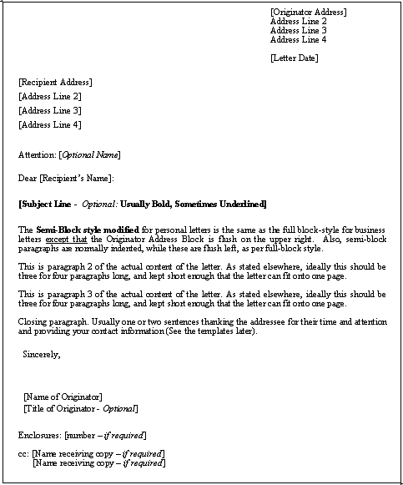
Example of Formal Communication
In a written letter, the formal communication style will demand that the layout of the piece of written communication follow a specific format that includes the date, header, salutation, body of the letter, close, signature lines and any indicators of enclosures all placed neatly upon company letterhead or personal stationery

Slide 21
Other Formal Communication
Other forms of formal communications include newsletters, legal advisories, invitations, awards, and letters of congratulations. Non-written formal communication devices are in-person communications in the forms of departmental meetings, telephone calls, conferences and special interviews. Some publications that are devoted to a special purpose, such as a company’s annual report, are formal communications.

Slide 22
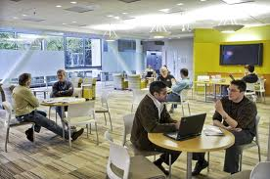
Informal Communication
informal communication is like dressing casually and wearing slippers around the house

Slide 23
Informal Communication
Much informal communication occurs on a person-to-person basis, in a face-to-face manner, without ceremony or fanfare.
Other ways to communicate in an informal manner may include texting, post-it notes, an informal drop in visit to another person, or a quick and spontaneous meeting.

